Slide 1
Get started with Azure OpenAI Service
Notes:
Before delivering this presentation, review the associated module on Microsoft Learn (https://aka.ms/mslearn-start-azure-openai).
The goal of this presentation is to describe how to provision the Azure OpenAI service, select and deploy a model, and use the Playground in Azure OpenAI Studio to submit prompts and review results from models.
The estimated time to present these slides is 40 minutes, plus 30 minutes to complete the hands-on exercise.
Note that students require an Azure subscription with approved access to the Azure OpenAI service to complete the exercise. If this is not the case, consider performing the exercise as a demonstration (for which you will require an Azure subscription with access to the Azure OpenAI service!)

Slide 2
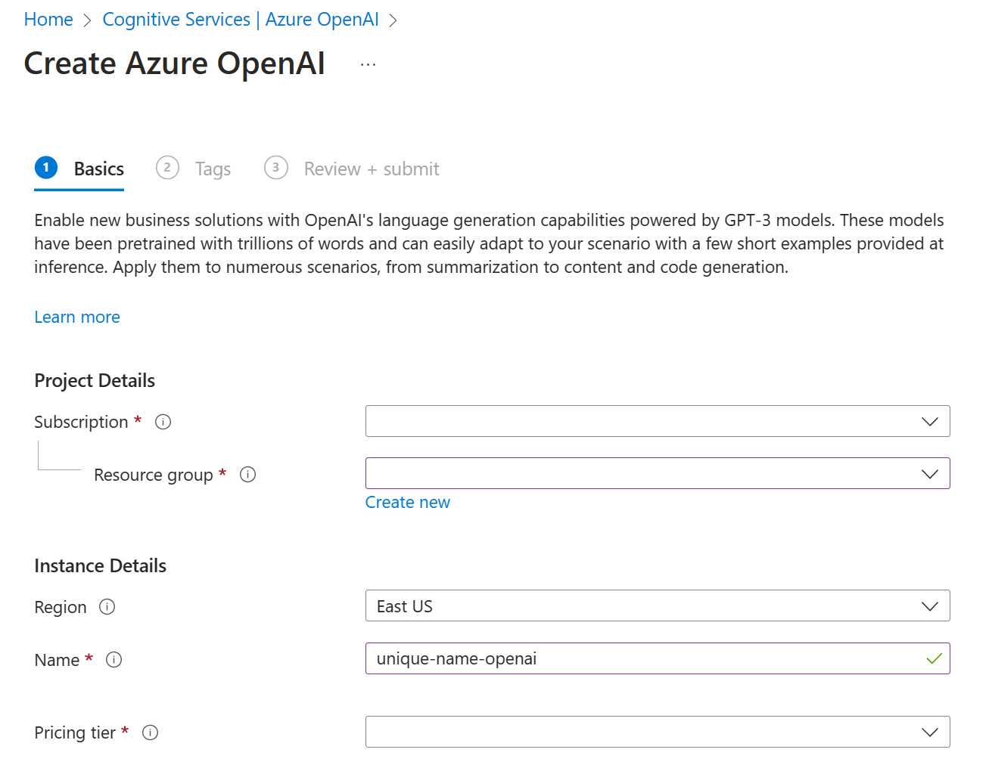
Provision an Azure OpenAI resource in Azure
Apply for access to the Azure OpenAI service:
https://aka.ms/oaiapply
Create an Azure OpenAI resource in the Azure portal
Alternatively, use the Azure CLI
az cognitiveservices account create \
-n MyOpenAIResource \
-g MyResourceGroup \
-l eastus \
--kind OpenAI \
--sku s0 \
--subscription subscriptionID
Notes:
Access approval for the Azure OpenAI service can take several days and is not guaranteed.
Once approved, you can create two Azure OpenAI resources per region.
Azure OpenAI Service provides access to many types of models. Certain models are only available in select regions. Consult the Azure OpenAI model availability guide at https://learn.microsoft.com/azure/cognitive-services/openai/concepts/models#model-summary-table-and-region-availability for region availability.

Slide 3
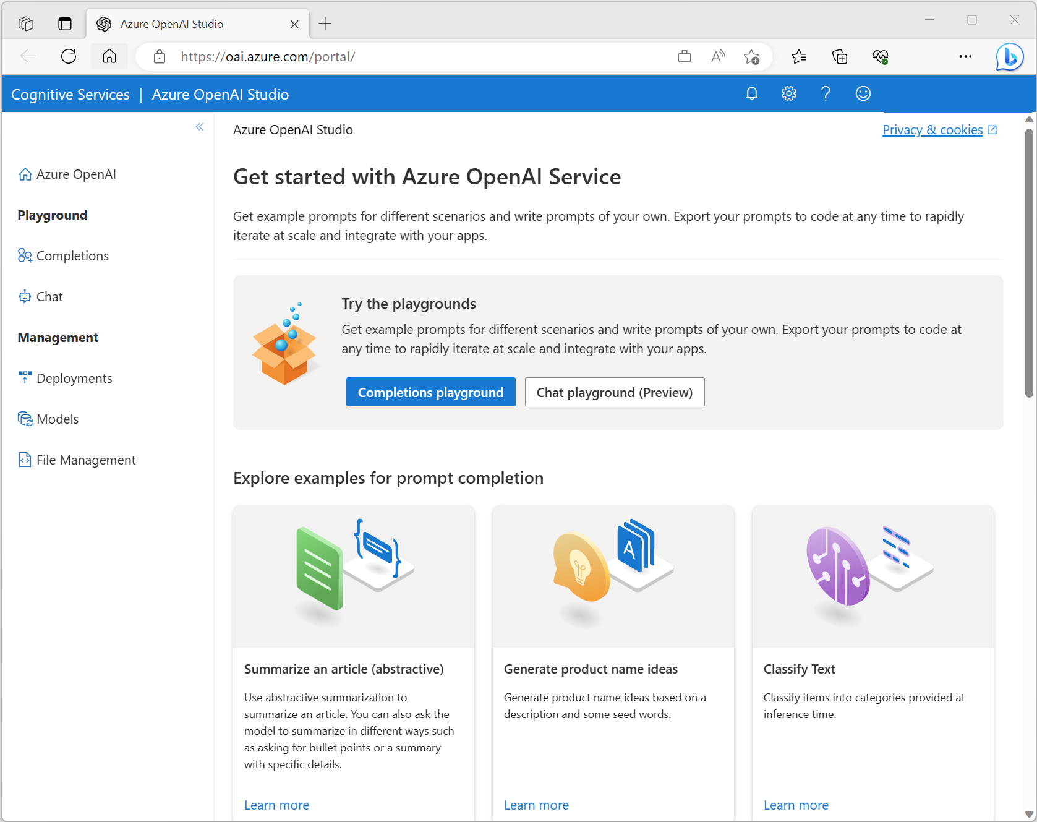
Azure OpenAI Studio
Web portal for working with Azure OpenAI models:
https://oai.azure.com/
View and deploy base models
Manage fine tuning and data files for custom models
Test models in visual playgrounds:
Completions (GPT-3 and earlier models)
Chat (GPT-3.5-Turbo and later models)
Notes:
Azure OpenAI Studio provide a web-based portal in which you can manage the models and deployments in your Azure OpenAI resource. You can access it from the resource page in the Azure portal or directly at https://oai.azure.com/.

Slide 4
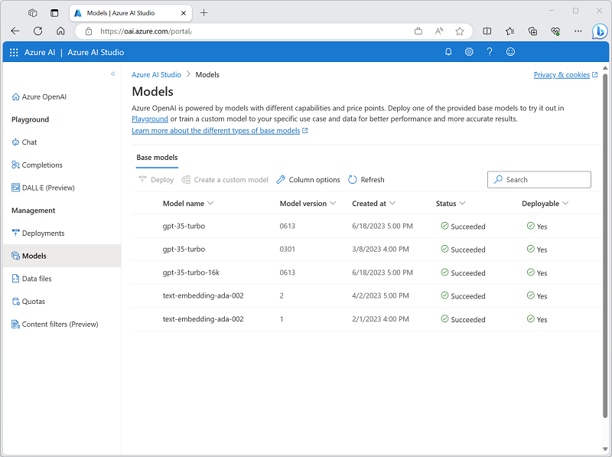
Types of generative AI model
Model Family | Description
GPT-4 | Newest, most capable chat-based models for language and code generation (restricted)
GPT-3.5 | Natural language and code-generation models
Embeddings | Models that use embeddings for specific tasks (similarity, text search, and code search)
DALL-E | Image-generation model (restricted preview)
Notes:
The newer GPT-4 models are generally the best choice for all language and code generation tasks.
The GPT-3 family includes the GPT-35-Turbo model on which the original release of the OpenAI ChatGPT service is based, and which supports the Chat API (and corresponding playground). It also includes four generations of language model, versions from A (Ada) to D (Davinci). Older models are less complex than newer ones (they’re smaller and consist of fewer layers). The right choice for a specific tasks depends on a balance of the speed at which the model can perform (smaller models tend to be faster) and how sophisticated their completions need to be (larger models tend to be more capable than smaller ones).
The Codex family contains GPT-3 models that are optimized to generate code from natural language prompts.
Embeddings-based models make use of embeddings (a specialized form of data encoding for text) to optimize specific tasks (evaluating text for similarities, searching text, and searching code)
DALL-E is a model for image-generation based on natural language prompts.

Slide 5
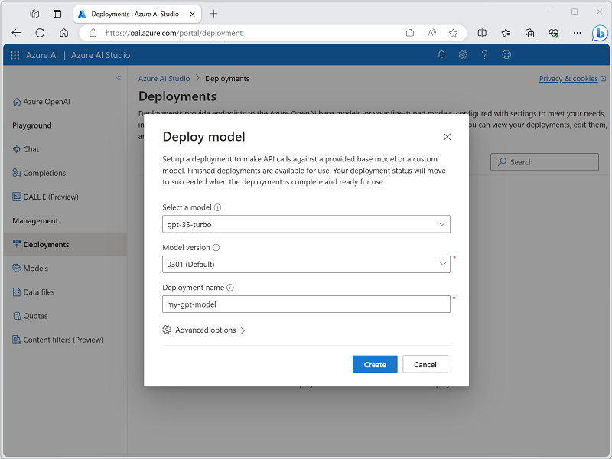
Deploying generative AI models
Deploy a model in Azure OpenAI Studio to use it
You can deploy one instance of each available model
Alternatively, use the Azure CLI
az cognitiveservices account deployment create \
-g myResourceGroupName \
-n MyOpenAIResource \
--deployment-name my-gpt-model \
--model-name gpt-35-turbo \
--model-version “0301" \
--model-format OpenAI \
--scale-settings-scale-type "Standard"
Notes:
In order to use a model in your Azure OpenAI resource, you must deploy an instance of an available models. Once deployed, you can use the REST API or SDK to connect to and consume the model from a client application; or use it directly in a playground in Azure OpenAI Studio.

Slide 6
Using prompts to get completions from models
Task | Prompt | Completion
Classifying content | Tweet: I enjoyed the training course. Sentiment: | Positive
Generating new content | Write a poem about databases | Databases, oh databases, You keep our information safe, From the small to the large, You store our data in a place.
Transformation/Translation | English: Hello French: | Bonjour
Summarization | Scotland is [long description of Scotland…] Summarize the previous text | Scotland is [summarized description…]
Continuation | One way to grow tomatoes is to | start with seeds…
Question answering | How many moons does Earth have? | Earth has one moon.
Chat | Setup, followed by messages… | A sequence of relevant responses
Notes:
The core way to interact with a model in Azure OpenAI is to provide a natural language prompt as input. Models then respond with a completion. The completion depends on a number of factors, including the text in the prompt, the way the prompt is presented (including any prompt engineering techniques applied), and the parameters that are set for the interaction (discussed on the next slide). This slide shows some examples of common types of task that you can accomplish with a generative model in Azure OpenAI service.
Chat is a more advanced scenario that is supported by more recent models (GPT-35-turbo and later), in which a setup statement is used to define the chat context and then the interaction consists of conversational “turns” in which the user submits messages to which the model returns relevant responses..

Slide 7
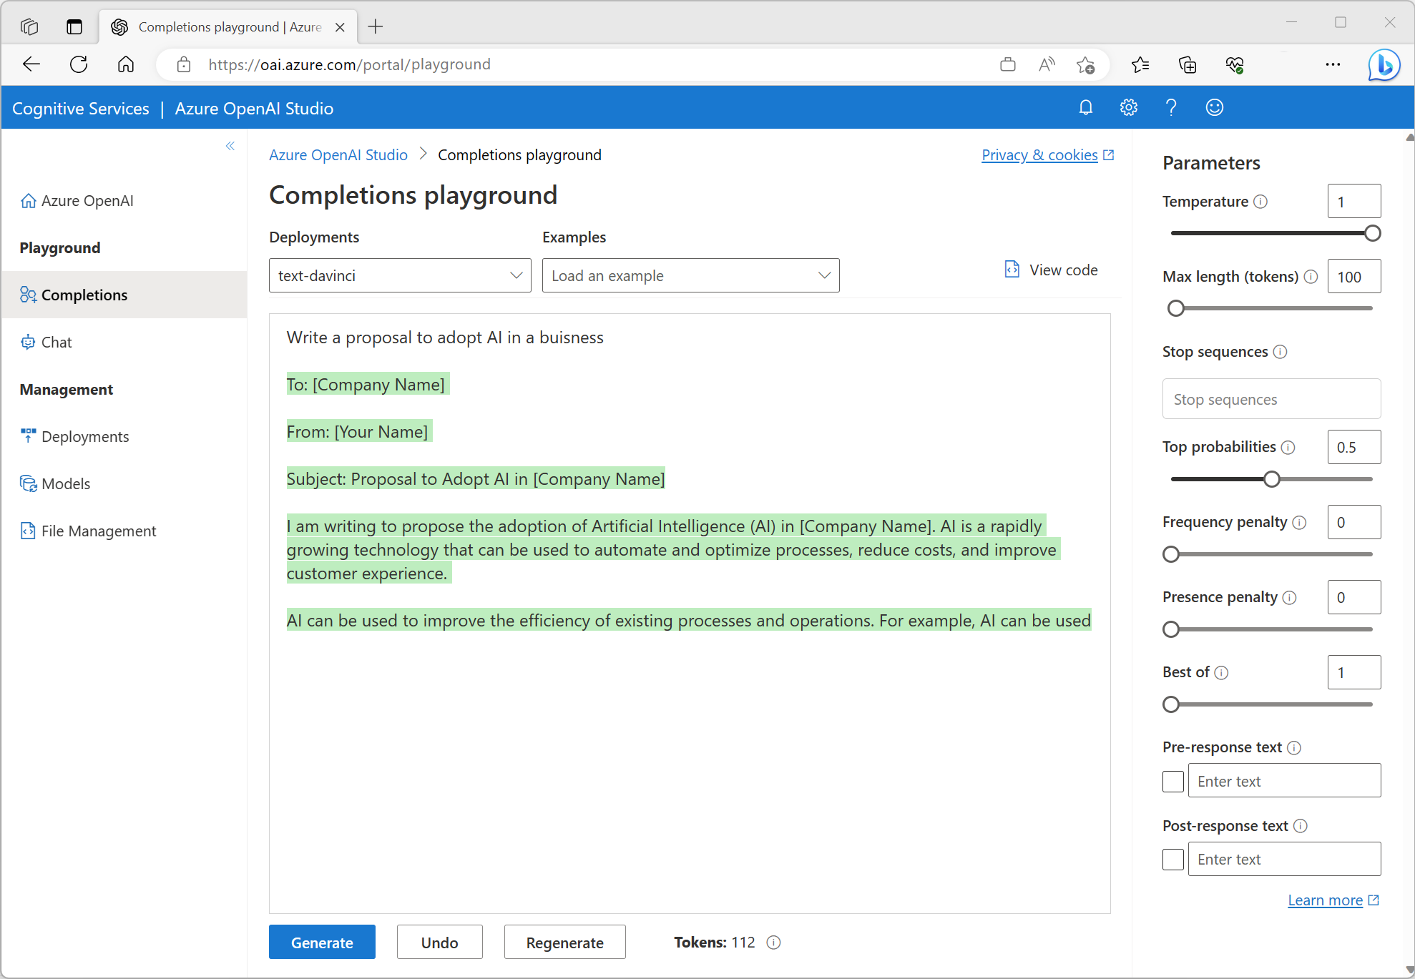
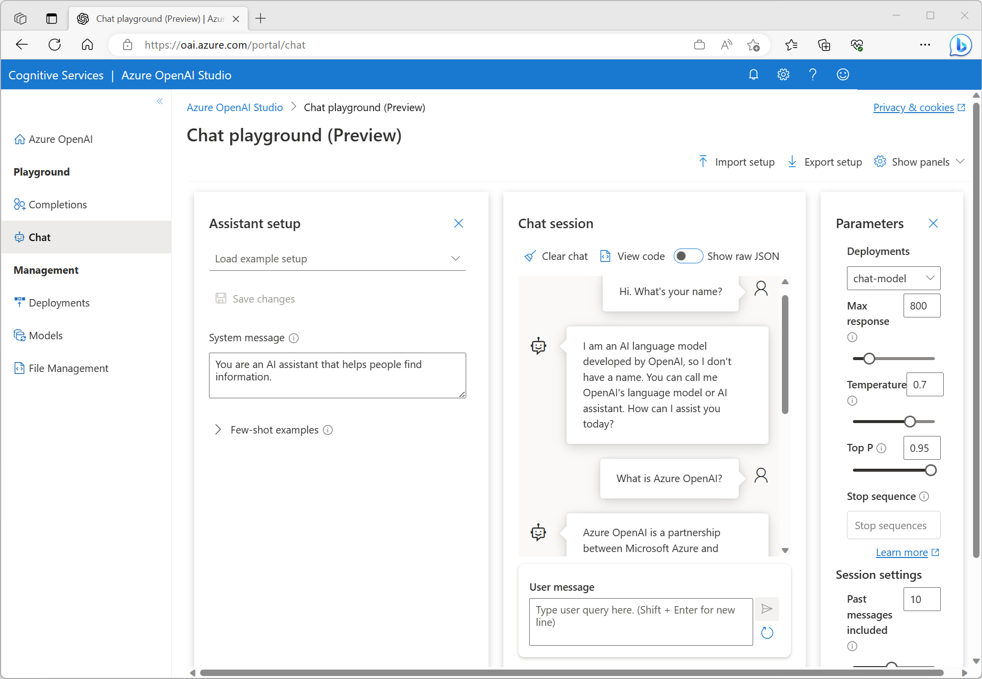
Testing models in Azure OpenAI Studio playgrounds
Completions playground
Chat playground
Notes:
Azure OpenAI Studio includes multiple playgrounds for specific types of model. For natural language generation models, the available playgrounds are:
The Completions playground – used for content generation tasks with GTP-3 family models
The Chat playground – used for chat interactions with GPT-35-Turbo and later models.
Each playground enables you to enter prompts and to set parameters that control the completions returned by the model.
When using the Completions playground, you can set the following parameters:
Temperature: Controls randomness. Lowering the temperature means that the model produces more repetitive and deterministic responses. Increasing the temperature results in more unexpected or creative responses. Try adjusting temperature or Top P but not both.
Max length (tokens): Set a limit on the number of tokens per model response. The API supports a maximum of 4000 tokens shared between the prompt (including system message, examples, message history, and user query) and the model's response. One token is roughly four characters for typical English text.
Stop sequences: Make responses stop at a desired point, such as the end of a sentence or list. Specify up to four sequences where the model will stop generating further tokens in a response. The returned text won't contain the stop sequence.
Top probabilities (Top P): Similar to temperature, this controls randomness but uses a different method. Lowering Top P narrows the model’s token selection to likelier tokens. Increasing Top P lets the model choose from tokens with both high and low likelihood. Try adjusting temperature or Top P but not both.
Frequency penalty: Reduce the chance of repeating a token proportionally based on how often it has appeared in the text so far. This decreases the likelihood of repeating the exact same text in a response.
Presence penalty: Reduce the chance of repeating any token that has appeared in the text at all so far. This increases the likelihood of introducing new topics in a response.
Pre-response text: Insert text after the user’s input and before the model’s response. This can help prepare the model for a response.
Post-response text: Insert text after the model’s generated response to encourage further user input, as when modeling a conversation.
When using the Chat playground, you can customize the setup description to set the context for the chat session; and also set the following parameters:
Max response: Set a limit on the number of tokens per model response. The API supports a maximum of 4000 tokens shared between the prompt (including system message, examples, message history, and user query) and the model's response. One token is roughly four characters for typical English text.
Top P: Similar to temperature, this controls randomness but uses a different method. Lowering Top P narrows the model’s token selection to likelier tokens. Increasing Top P lets the model choose from tokens with both high and low likelihood. Try adjusting temperature or Top P but not both.
Past messages included: Select the number of past messages to include in each new API request. Including past messages helps give the model context for new user queries. Setting this number to 10 will include five user queries and five system responses.

Slide 8

Exercise: Get started with Azure OpenAI Service
Use the hosted lab environment if provided, or view the lab instructions at the link below:
https://aka.ms/mslearn-get-started-azure-openai
Notes:
The exercise will take a minimum of 30 minutes to complete.
Not all students work at the same pace, so you should allow additional time as necessary for your class.

Slide 9

Knowledge check
What do you need in order to test a generative AI model using the Azure OpenAI Service Studio?
A deployed model name and Azure command line interface
An Azure OpenAI resource and an Azure Cognitive Services resource
An Azure OpenAI resource, a deployed model, and a playground
Which parameter could you adjust to change the randomness or creativeness of completions
Temperature
Frequency penalty
Stop sequence
Which Azure OpenAI Studio playground is able to support conversational interactions that consist of a sequence of messages?
Completions
Chat
Bot
Notes:
Allow students a few minutes to think about the questions, and then use the animated slide to reveal the correct answers.

Slide 10

Further reading
Get started with Azure OpenAI Service
https://aka.ms/mslearn-start-azure-openai
Notes:
Encourage students to review the online material on Microsoft Learn on which this presentation is based.

